Slide 1
PBox2D
2013.10.01
gowhd22@naver.com
This presentation is based on the underline ppt file
http://pds21.egloos.com/pds/201304/09/15/Class4-PhysicalLibrary.pptx

Slide 2








Slide 3



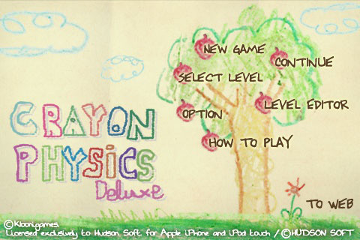

Slide 4
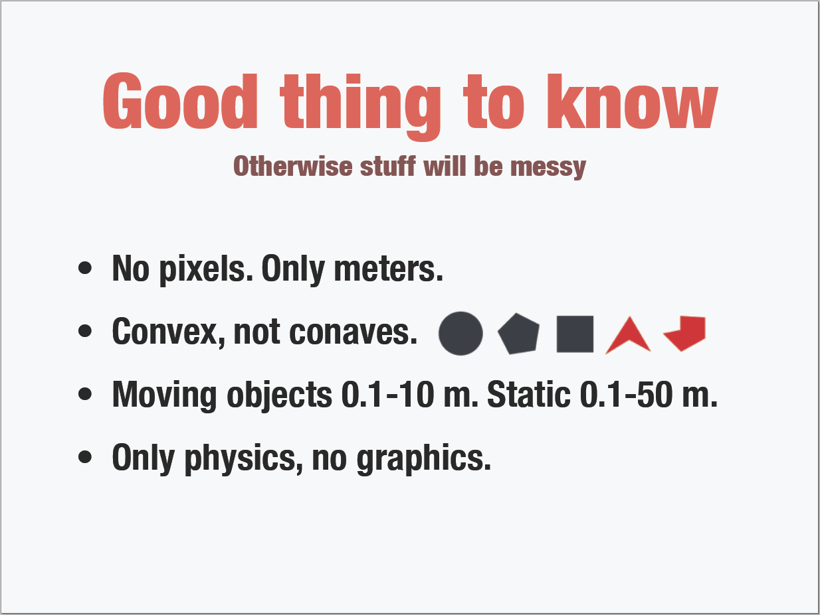

Slide 5
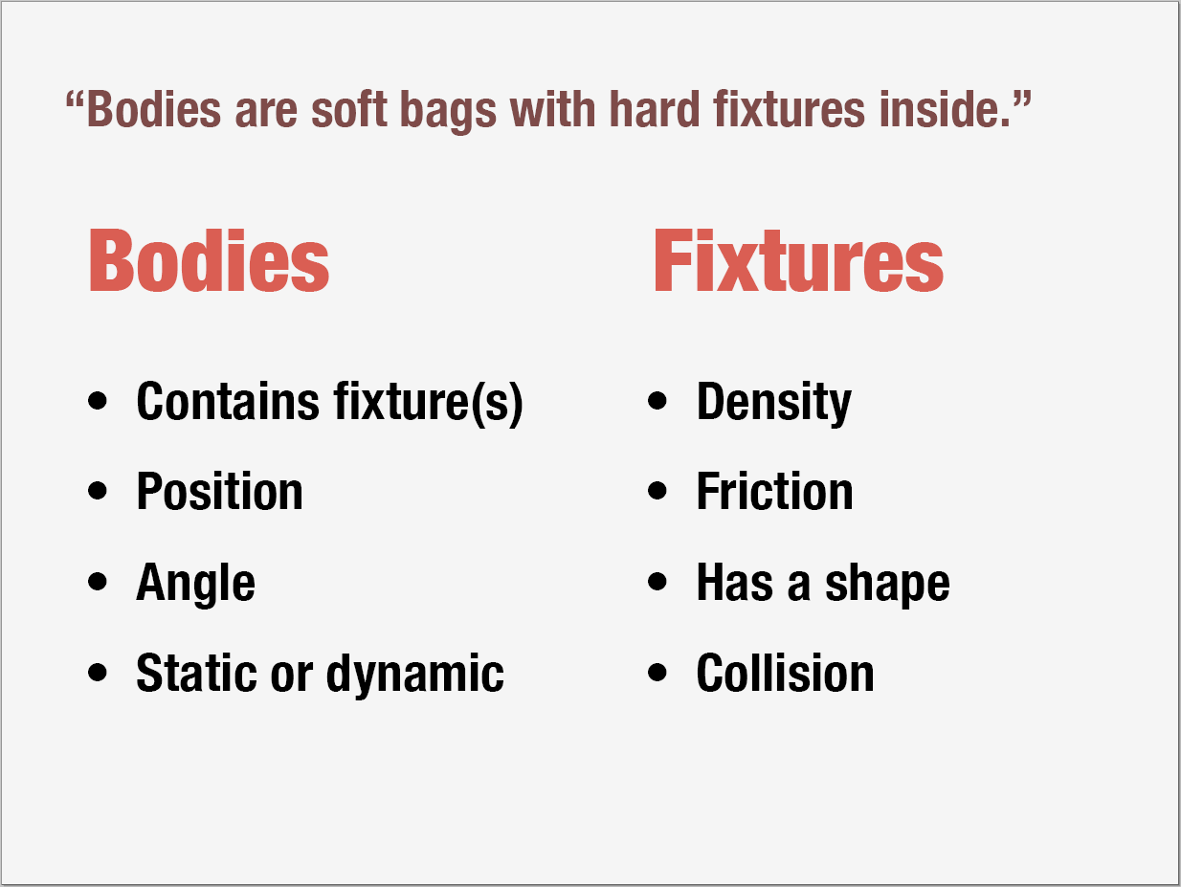

Slide 6
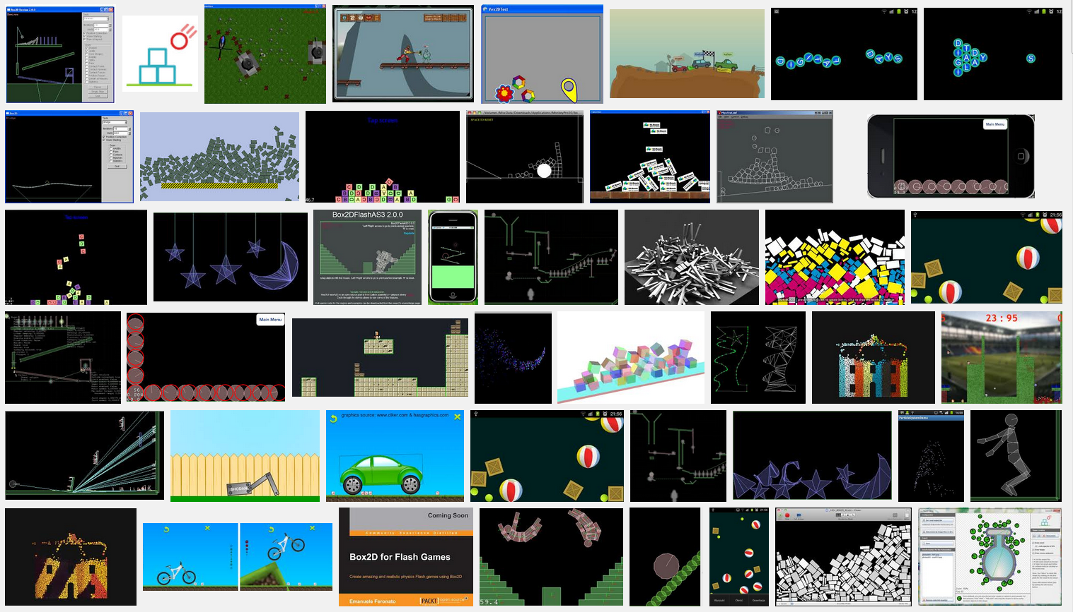

Slide 7
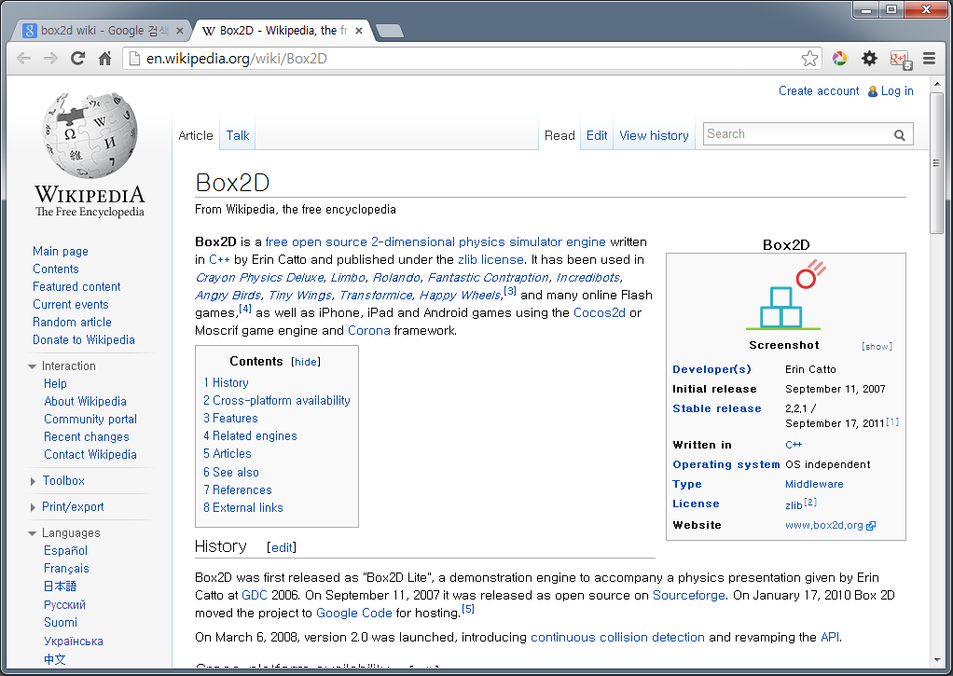
http://en.wikipedia.org/wiki/Box2D

Slide 8
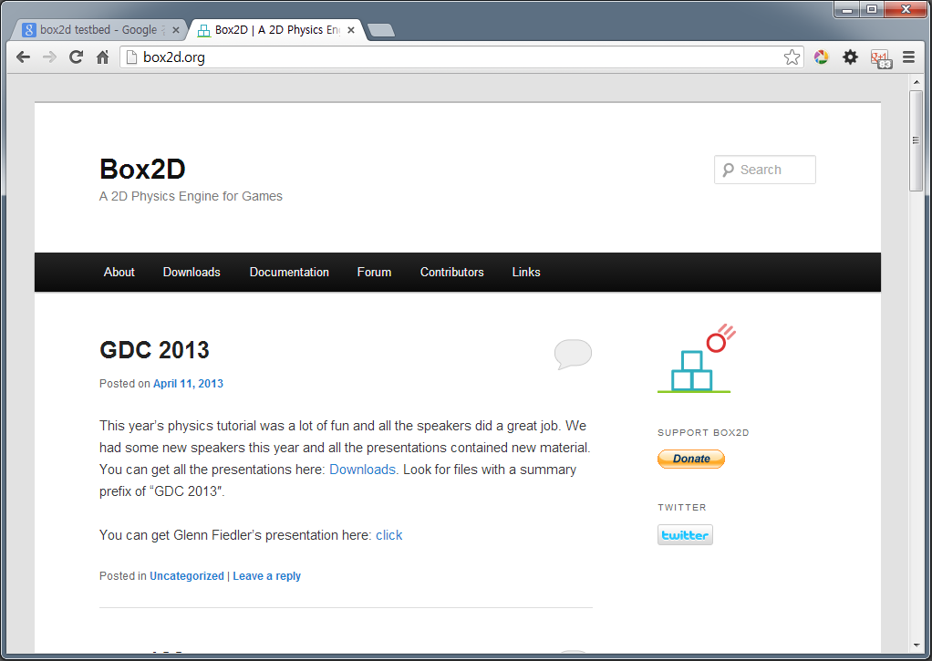
https://box2d.org/

Slide 9
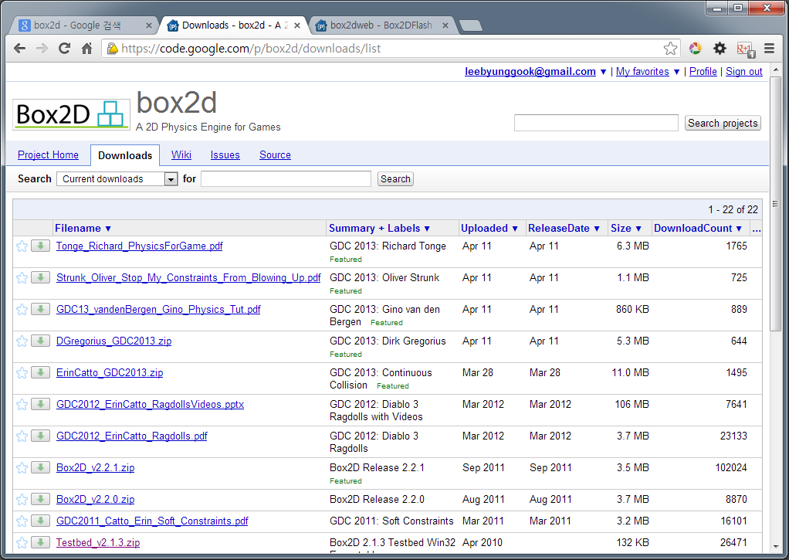
https://code.google.com/p/box2d/downloads/list/

Slide 10
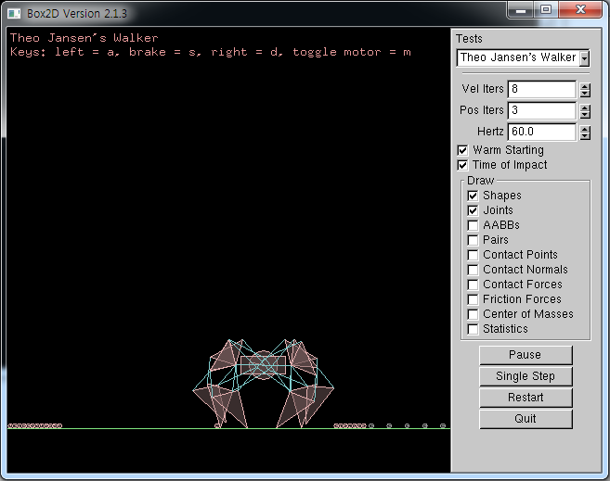
Box2D Testbed

Slide 11
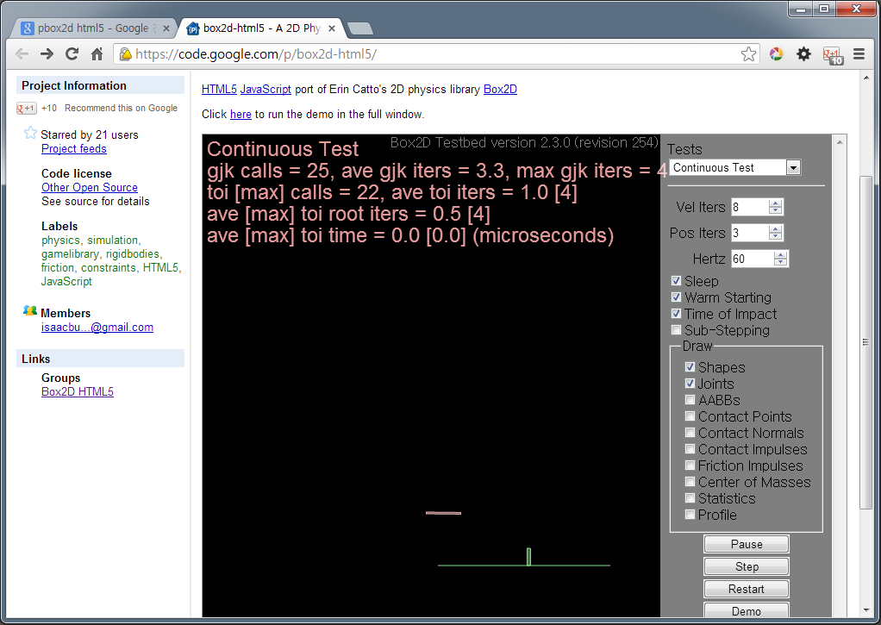
https://code.google.com/p/box2d-html5/

Slide 12
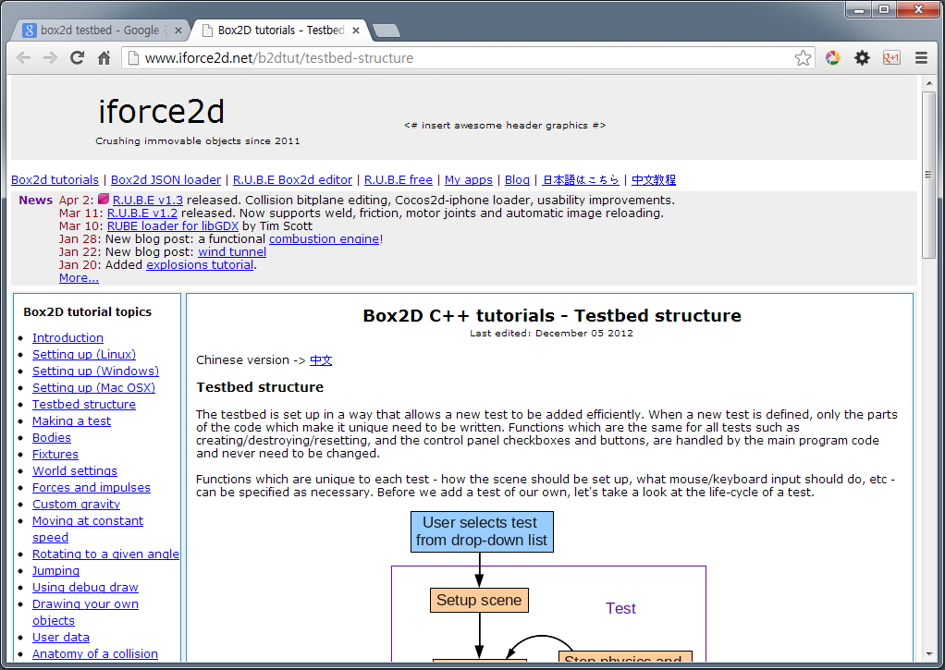
http://www.iforce2d.net/b2dtut/

Slide 13
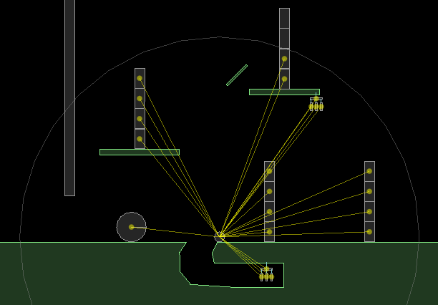
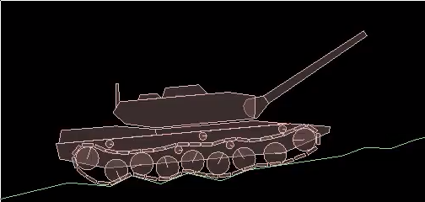
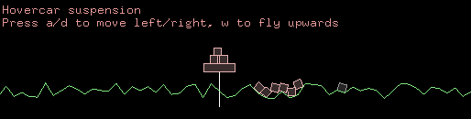
iforce2d advanced topics
http://www.iforce2d.net/b2dtut/

Slide 14
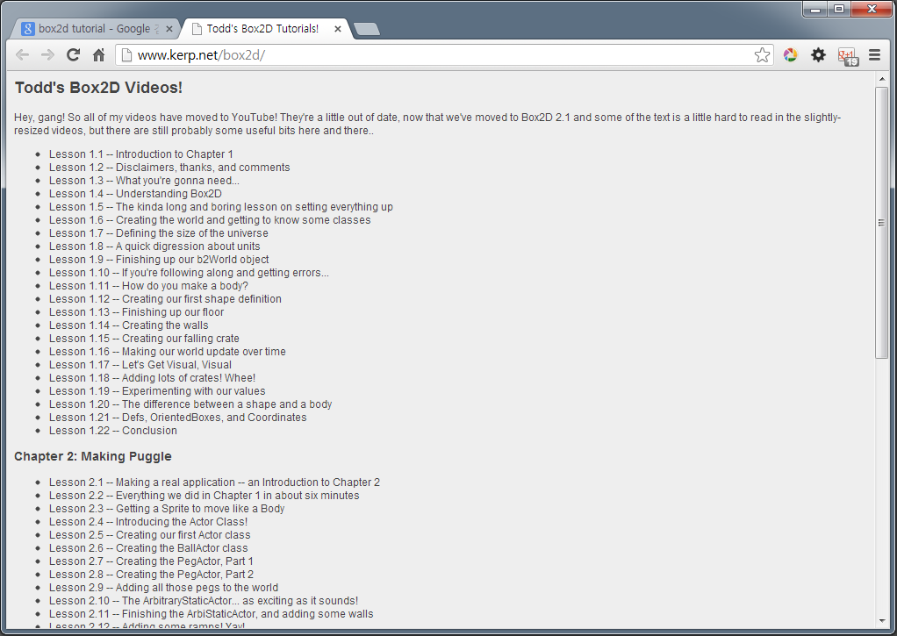
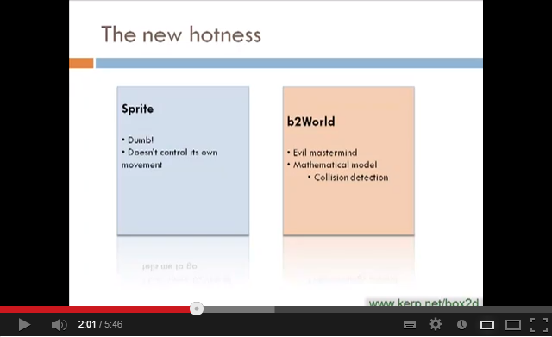
http://www.kerp.net/box2d/

Slide 15
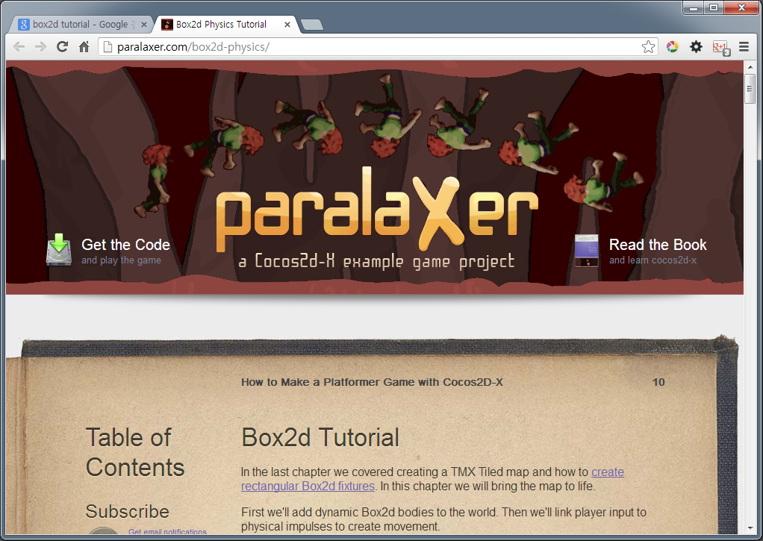
http://paralaxer.com/box2d-physics/

Slide 16
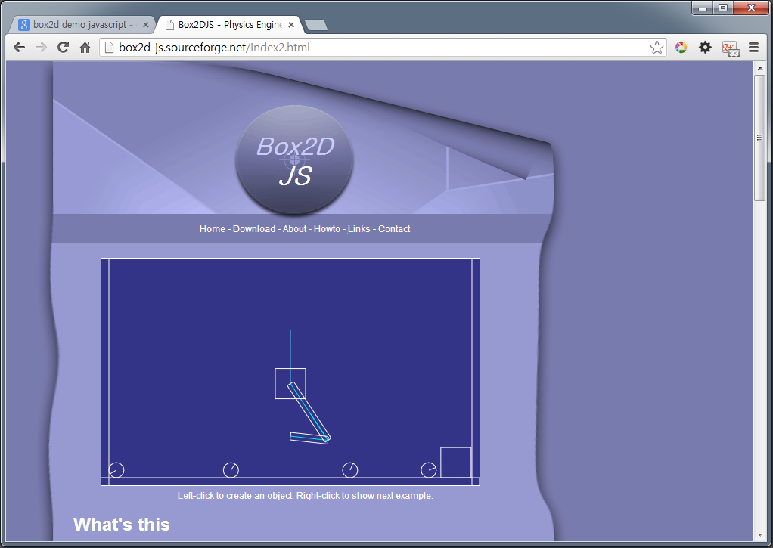
http://box2d-js.sourceforge.net/index2.html

Slide 17
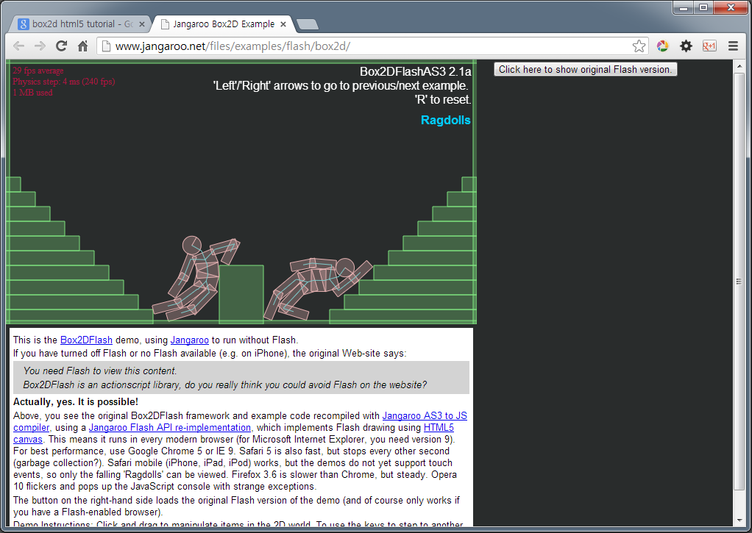
http://www.jangaroo.net/files/examples/flash/box2d/

Slide 18
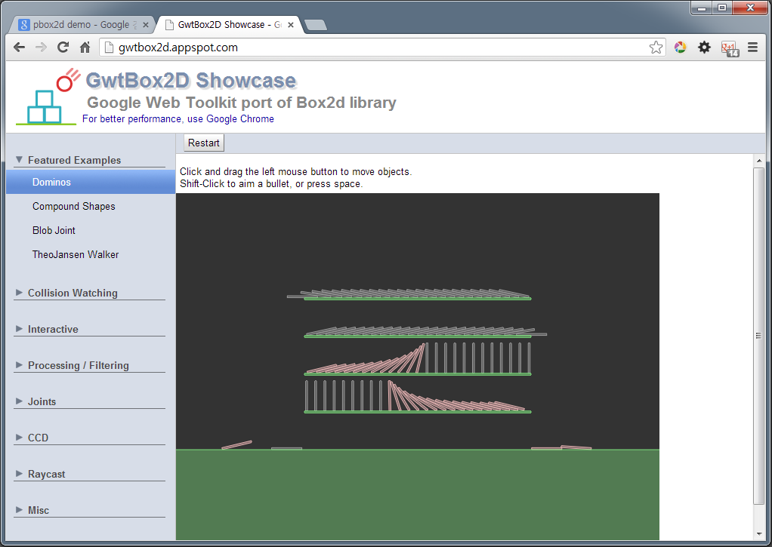
http://gwtbox2d.appspot.com/

Slide 19
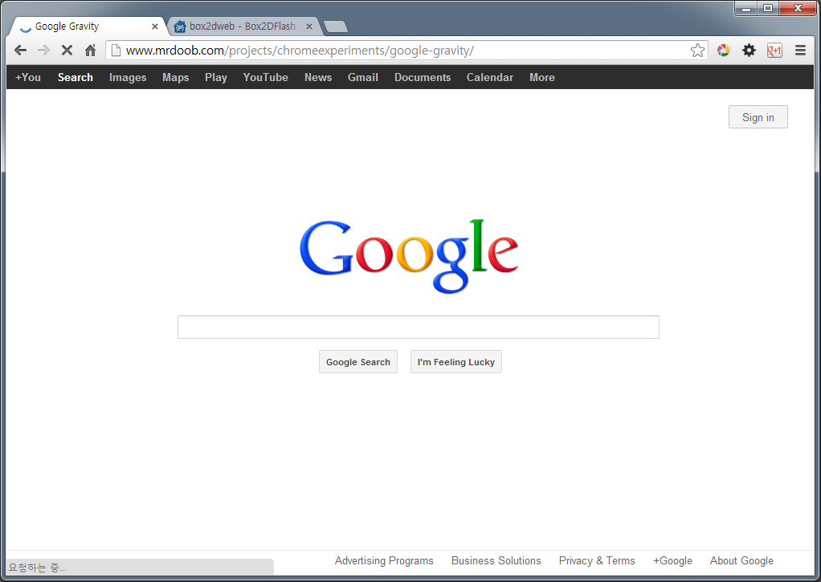
http://www.mrdoob.com/projects/chromeexperiments/google-gravity/

Slide 20
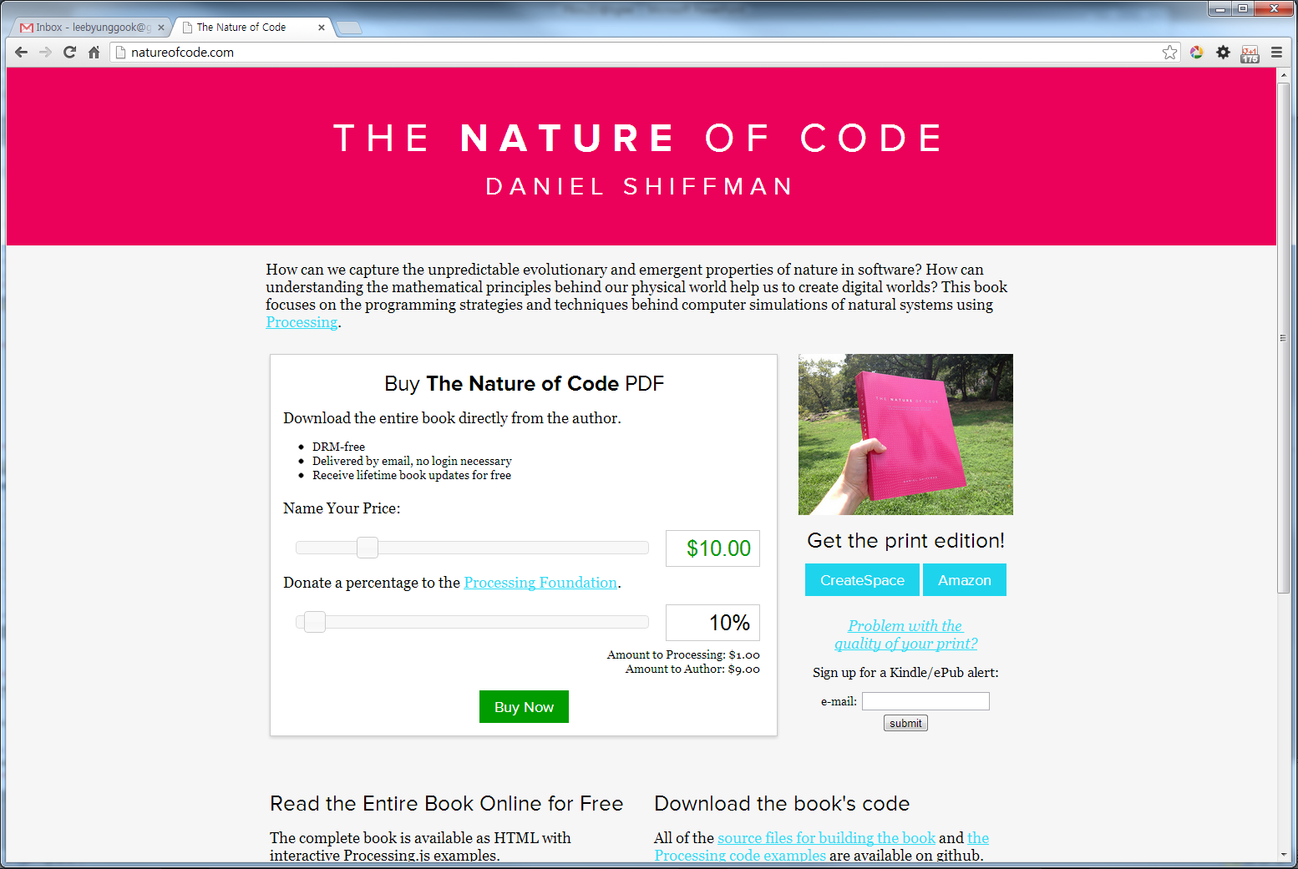
http://natureofcode.com/book/chapter-5-physics-libraries/

Slide 21
Q & A

